Slide 1
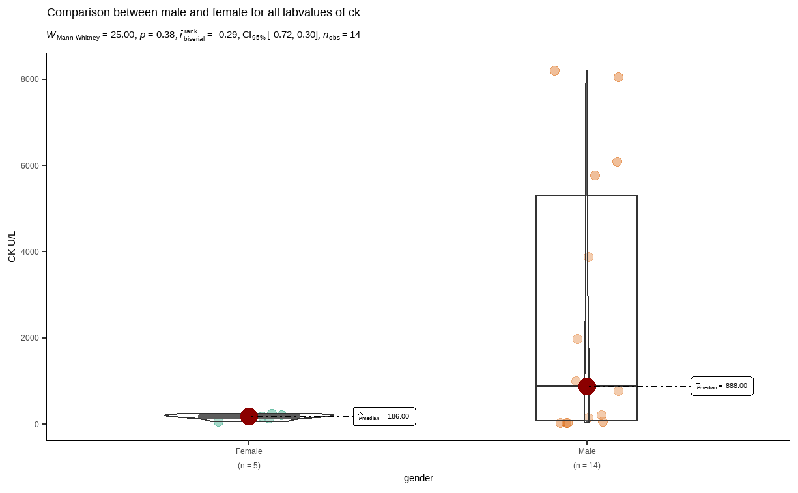
variable <chr> | gender <chr> | statistic <dbl> | p_value <dbl> | sample <dbl>
labreads | Female | 0.9677362 | 0.860534803 | 5
labreads | Male | 0.7848556 | 0.003262458 | 14

